Slide 1

Semi-Personalized Pricing: Algorithms and Implications
Michael L. Hamilton

Slide 2



Semi-Personalized Pricing: Algorithms and Implications
Michael L. Hamilton w/
Titing Cui ^{[1,2]} , Max Biggs ^{[2]} , Enfeng Xing ^{[2]}
[1] Cui and Hamilton, 2024. Optimal Feature-Based Market Segmentation and Pricing
[2] Biggs et al, 2025. Can Personalized Pricing be Progressive?

Slide 3
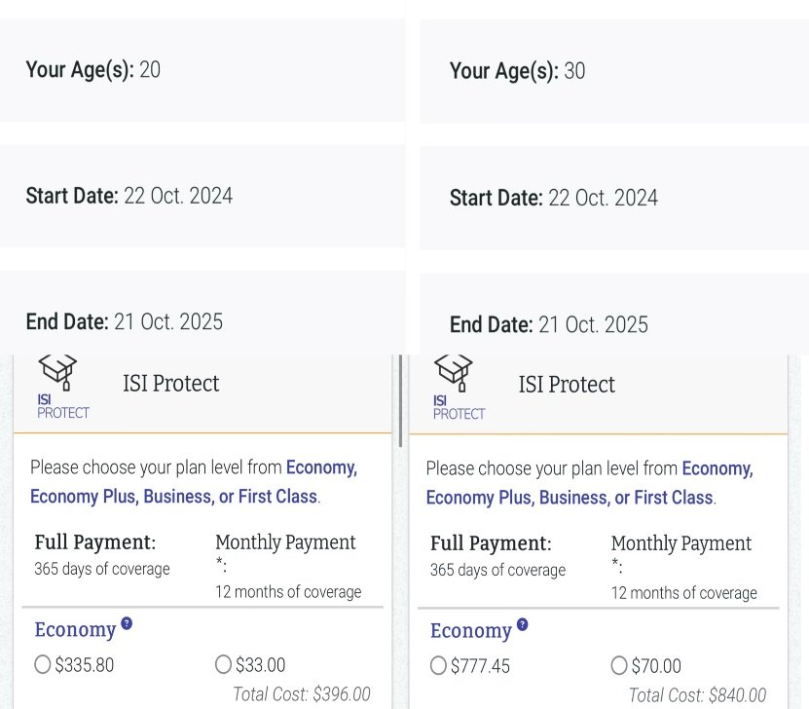
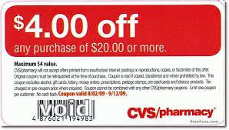
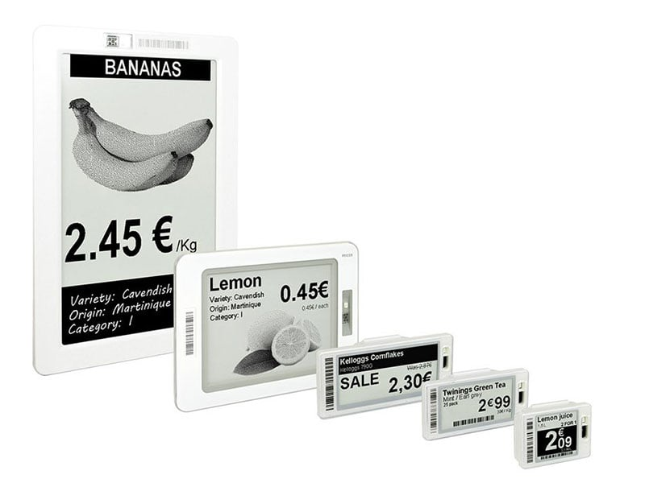
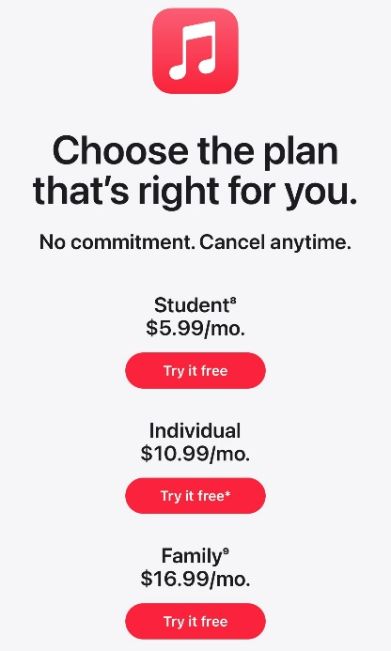
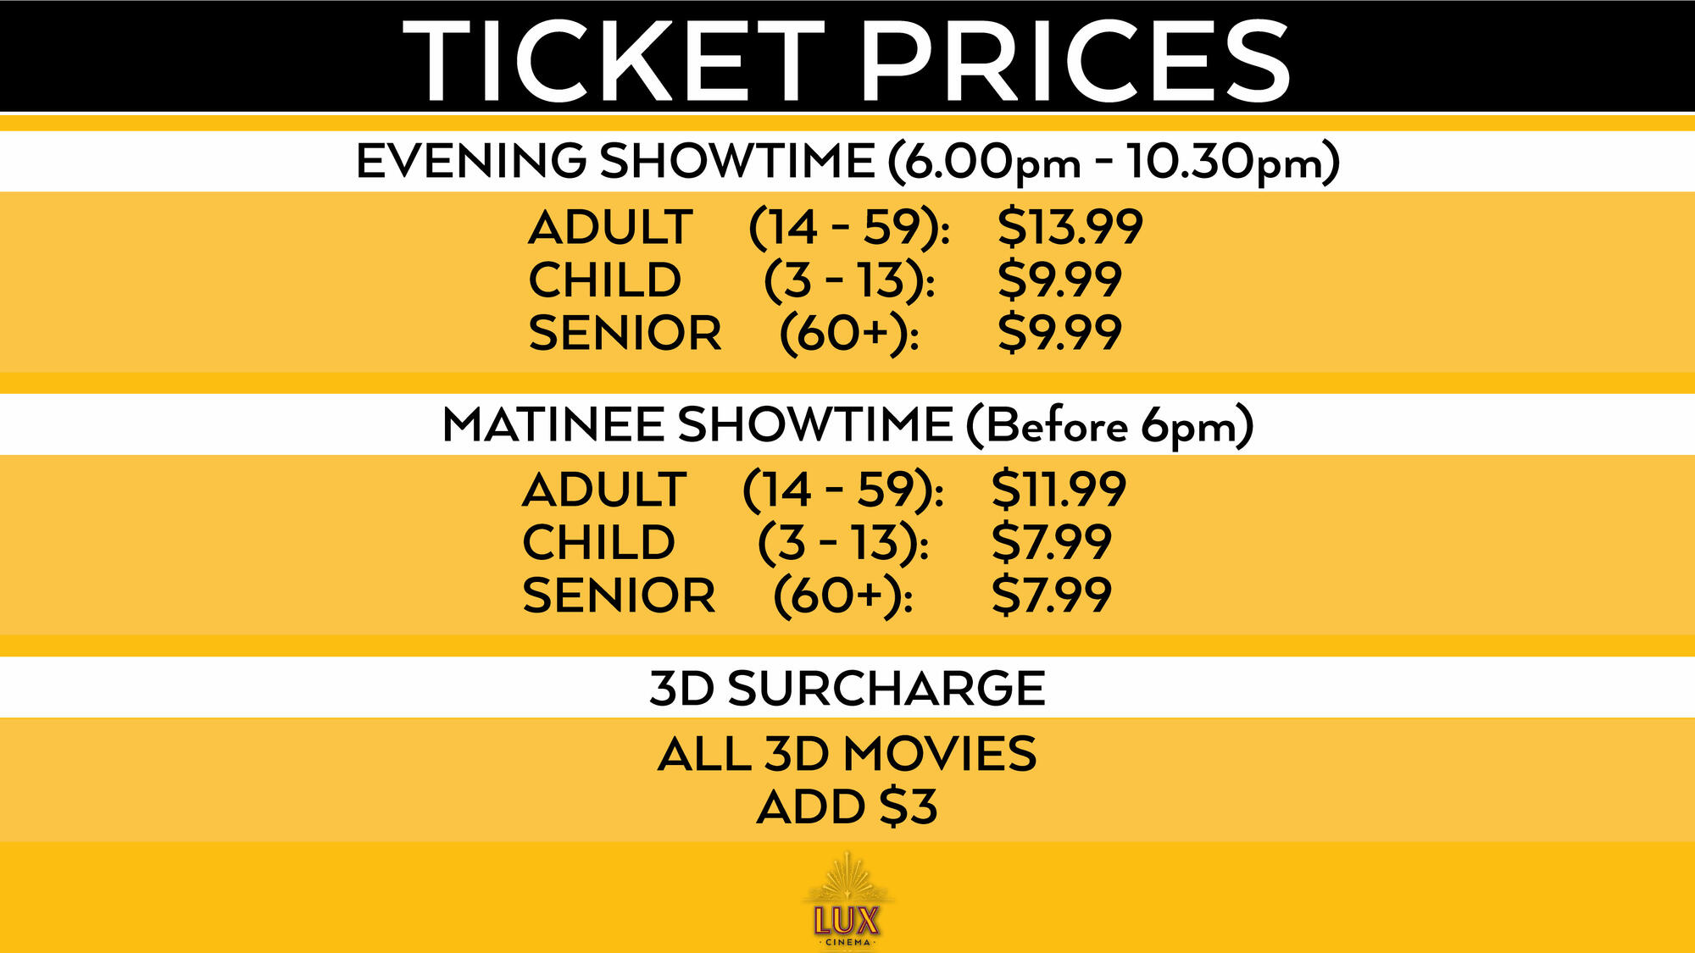

Personalized Pricing
Personalized Pricing is when the price for a good is chosen based on consumer specific observables.
Third Degree Price Discrimination, Surveillance Pricing
In many markets prices for goods are personalized
Airline ticket
Grocery (coupons)
Insurance markets
Loans
Software licenses
Movie theater tickets
Many more

Slide 4
Personalized Pricing
Personalized Pricing is when the price for a good is chosen based on consumer specific observables.
Third Degree Price Discrimination, Surveillance Pricing
Positives
“Increase your bottom line without changing your product line”
Discounts for some customers

Slide 5
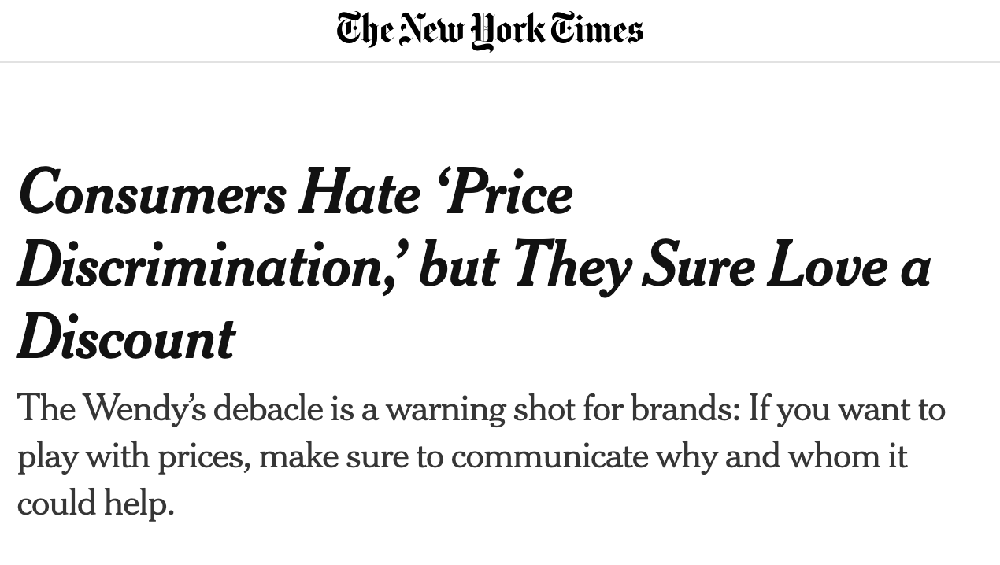
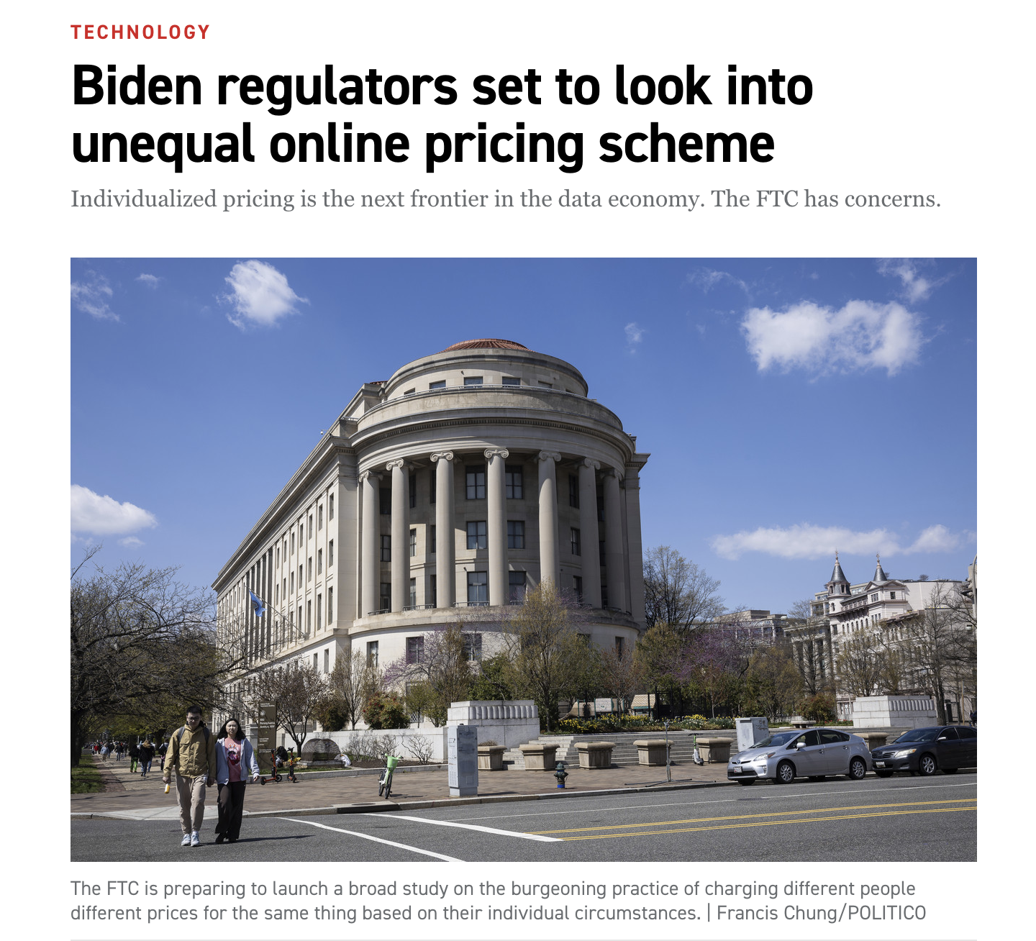
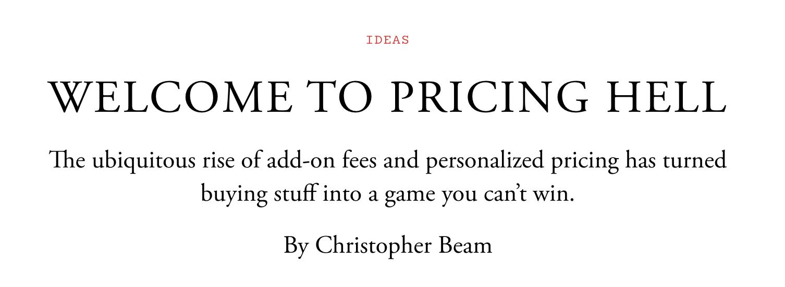
Personalized Pricing
Personalized Pricing is when the price for a good is chosen based on consumer specific observables.
Third Degree Price Discrimination, Surveillance Pricing
Positives
Negatives
“Increase your bottom line without changing your product line”
Customer blow back
Governmental regulation
Uneven effectiveness
Discounts for some customers

Slide 6
Personalized Pricing
Personalized Pricing is when the price for a good is chosen based on consumer specific observables.
Third Degree Price Discrimination, Surveillance Pricing
The future of personalized pricing will be tactical
Companies that can make personalized pricing palatable will succeed
Naively charging maximum willingness-to-pay likely will fail

Slide 7
Personalized Pricing
Personalized Pricing is when the price for a good is chosen based on consumer specific observables.
Third Degree Price Discrimination, Surveillance Pricing
The future of personalized pricing will be tactical
Companies that can make personalized pricing palatable will succeed
Naively charging maximum willingness-to-pay likely will fail
Semi-Personalized Pricing uses a limited number of distinct prices which segments the market
Granularity of the pricing depends on information quality and operational constraints
Segments customers by the price they receive

Slide 8
Talk Outline
C1: Framework for semi-personalized pricing
Captures the range of semi-personalized pricing policies that appear in practice. Hierarchy of price discrimination parameterized by number of distinct prices
C2(a): Algorithms for setting semi-personalized pricing policies
We describe when the it is algorithmically easy or hard to optimally segment and price markets and explain why.
C2(b): Structural results for optimal semi-personalized pricing
Characterize how increasing level price discrimination impacts revenue
C3: What does semi-personalized pricing mean for customers?
Introduce the proportional welfare, and give theory that a modest level of price discrimination is often equity promoting
Notes:
We consider a more realistic version of personalized pricing we term feature-based
pricing, and show how to transform our previous bounds into bounds on the value of
feature-based pricing over single price strategies (cf. Lemma 9 and Theorem 5) via a
novel extension theorem. These bounds makes explicit the relationship between the
accuracy of a sellers prediction model, and value of personalized pricing in a market.

Slide 9
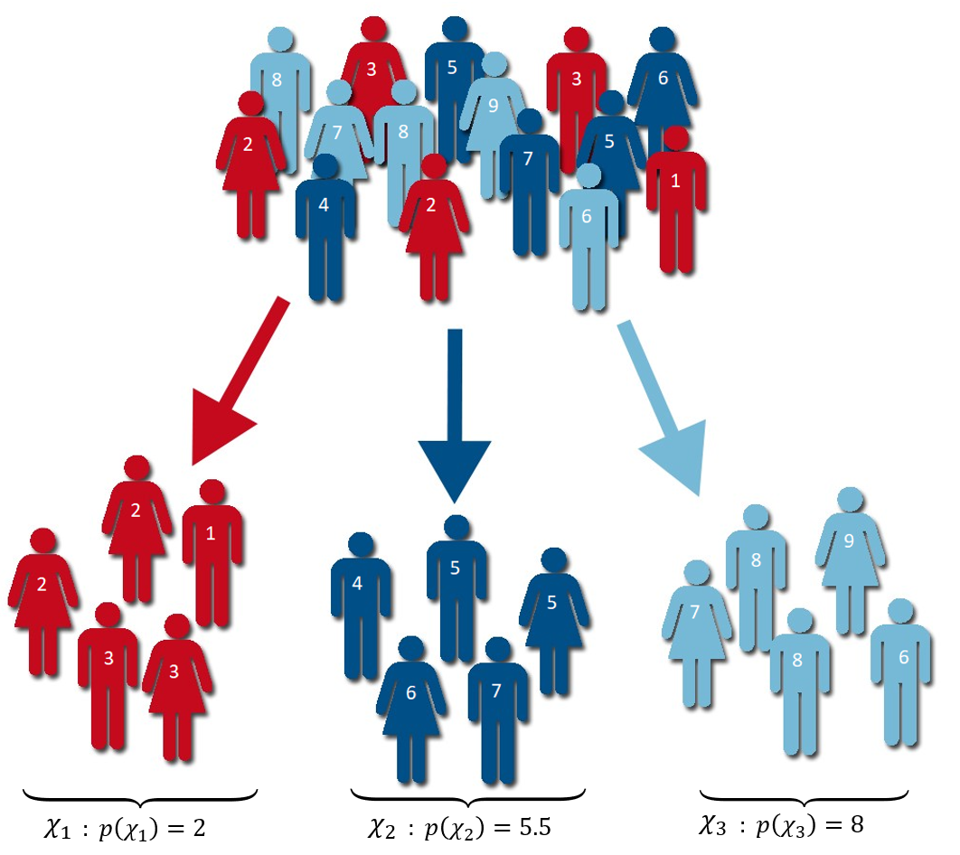
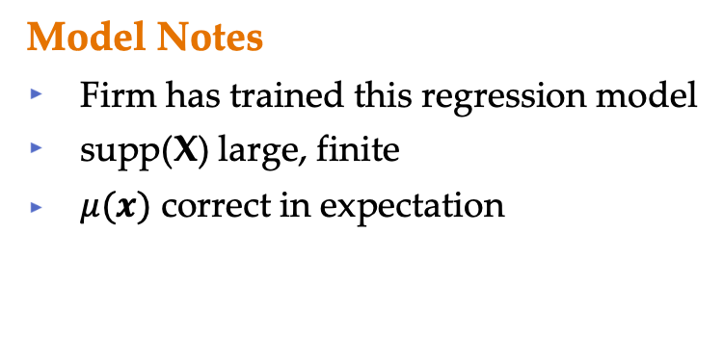
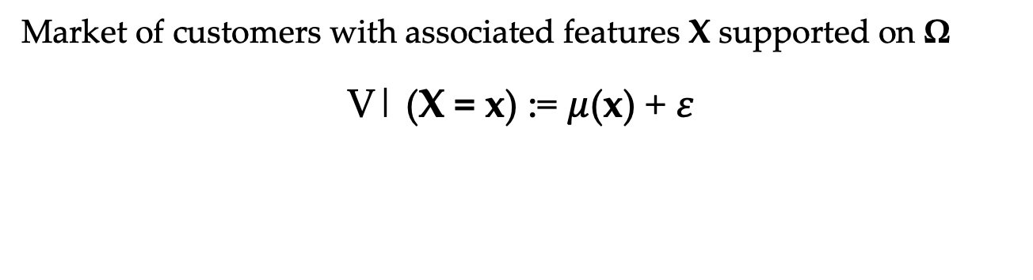
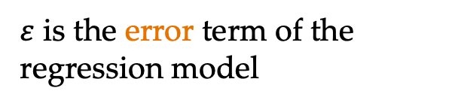
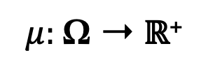
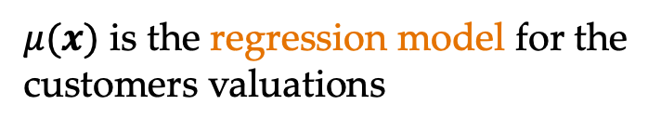
Valuation Model
Market of customers with associated features X supported on Ω
V| (X = x) := $μ$(x) + 𝜀
$μ(x)$ is the regression model for the customers valuations
$\text{ε}$ is the error term of the regression model
$μ:$Ω ➝ ℝ⁺
𝜀 ⫫ X, E[𝜀] = 0
Model Notes
Firm has trained this regression model
supp(X) large, finite
$μ(x)$ correct in expectation
Notes:
Sigma is all possible contexts
X represents the context of a random customer
Mu(X) is the predicted valuation for a customer

Slide 10
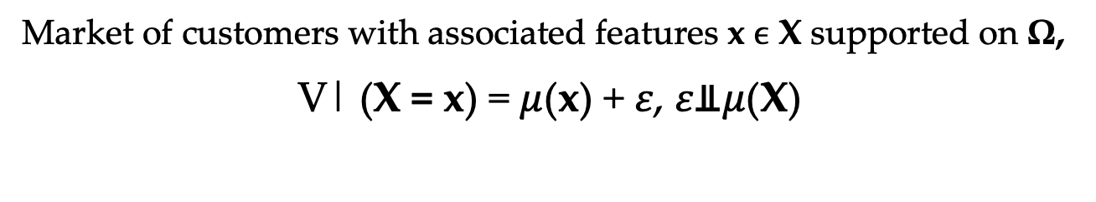
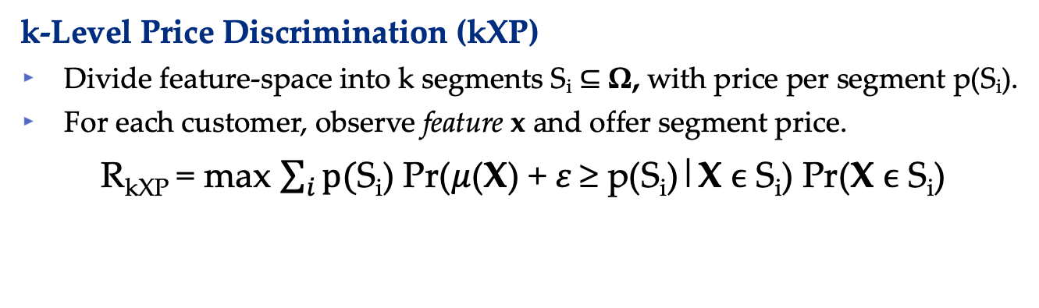
Semi-Personalized Pricing Model
Market of customers with associated features x ϵ X supported on Ω,
V| (X = x) = $μ$(x) + 𝜀, 𝜀⫫$μ$(X)
k-Level Price Discrimination (kXP)
Divide feature-space into k segments S_{i} ⊆ Ω, with price per segment p(S_{i}).
For each customer, observe feature x and offer segment price.
R_{kXP} = max $\sum_{i}{p(}$S_{i}) Pr($μ$(X) + 𝜀 ≥ p(S_{i})|X ϵ S_{i}) Pr(X ϵ S_{i})
{S_{i}, p(S_{i})}
Model Notes
p(S_{i}) is an induced (monopoly) price per segment
k = 1 is regular uniform pricing, k → ∞ is fully personalized pricing

Slide 11
Semi-Personalized Pricing Model
Market of customers with associated features x ϵ X supported on Ω,
V| (X = x) = $μ$(x) + 𝜀, 𝜀⫫$μ$(X)
k-Level Price Discrimination (kXP)
Divide feature-space into k segments S_{i} ⊆ Ω, with price per segment p(S_{i}).
For each customer, observe feature x and offer segment price.
R_{kXP} = max $\sum_{i}{p(}$S_{i}) Pr($μ$(X) + 𝜀 ≥ p(S_{i})|X ϵ S_{i}) Pr(X ϵ S_{i})
{S_{i}, p(S_{i})}
Q1: How hard is finding the optimal k-level pricing is?

Slide 12
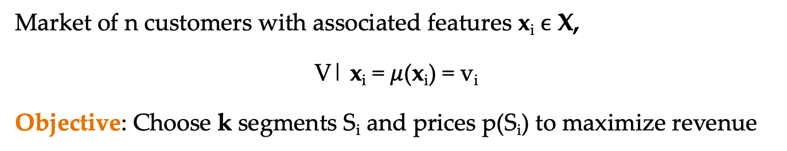
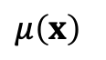
Warm-up: 𝜀 = 0
Market of n customers with associated features x_{i} ϵ X,
V| x_{i} = $μ$(x_{i}) = v_{i}
Objective: Choose k segments S_{i} and prices p(S_{i}) to maximize revenue
Example: k = 4
S₂
S₄
S₃
S₁
S₃
v₁
v₂
v₃
v₄
v₅
v₆
v₈
v₉
v₇
$μ\left(x\right)$
$8
$14
$18
$20
$21
$22
$25
$26
$30
p(S₁) = 14
p(S₂) = 20
p(S₃) = 22
p(S₄) = 25
Feasible Solution Notes
A solution is a grouping of valuations (segment) with a price
For k-level price, O(n^{k}) possible solutions

Slide 13
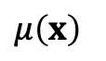
Warm-up: 𝜀 = 0
Market of n customers with associated features x_{i} ϵ X,
V| x_{i} = $μ$(x_{i}) = v_{i}
Objective: Choose k segments S_{i} and prices p(S_{i}) to maximize revenue
Example: k = 4
S₁
S₂
S₃
S₄
v₁
v₂
v₃
v₄
v₅
v₆
v₈
v₉
v₇
$μ\left(x\right)$
$8
$14
$18
$20
$21
$22
$25
$26
$30
p(S₁) = 14
p(S₂) = 20
p(S₃) = 25
p(S₄) = 30
Optimal Solution Notes
Optimal price in each segment (except the first) uses the lowest valuation
Optimal segments must be contiguous in valuation space

Slide 14
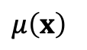
Warm-up: 𝜀 = 0
Market of n customers with associated features x_{i} ϵ X,
V| x_{i} = $μ$(x_{i}) = v_{i}
Objective: Choose k segments S_{i} and prices p(S_{i}) to maximize revenue
Observation:
S₁
S₂
v₁
v₂
v₃
v₄
v₅
v₆
v₈
v₉
v₇
…
$μ\left(x\right)$
$8
$14
$18
$20
$21
$22
$25
$26
$30
Must be the optimal 4-segmentation and pricing on market v₁ … v₉

Slide 15
Warm-up: 𝜀 = 0
Market of n customers with associated features x_{i} ϵ X,
V| x_{i} = $μ$(x_{i}) = v_{i}
Objective: Choose k segments S_{i} and prices p(S_{i}) to maximize revenue
Observation:
S₁
S₂
v₁
v₂
v₃
v₄
v₅
v₆
v₈
v₉
v₇
…
$μ\left(x\right)$
$8
$14
$18
$20
$21
$22
$25
$26
$30
Must be the optimal 2-segmentation and pricing on market v₁ … v₆
Must be the optimal 2-segmentation and pricing on market v₇ … v₉

Slide 16
Warm-up: 𝜀 = 0
Market of n customers with associated features x_{i} ϵ X,
V| x_{i} = $μ$(x_{i}) = v_{i}
Objective: Choose k segments S_{i} and prices p(S_{i}) to maximize revenue
S₁
S₂
v₁
v₂
v₃
v₄
v₅
v₆
v₈
v₉
v₇
…
$μ\left(x\right)$
$8
$14
$18
$20
$21
$22
$25
$26
$30
By dynamic programming we solve this problem by populating a table of size n² k where each cell corresponds to an interval [v_{i,} v_{j}] and a level k’ ≤ k

Slide 17

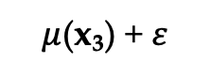
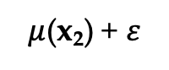
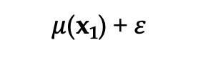
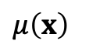
Semi-Personalized Pricing for General 𝜀
Market of n customers with associated features x_{i} ϵ X,
V| x_{i} = $μ$(x_{i}) + 𝜀
Objective: Choose k segments S_{i} and prices p(S_{i}) to maximize revenue
Example:
$μ$(x₁) + 𝜀
$μ$(x₂) + 𝜀
$μ$(x₃) + 𝜀
$μ\left(x\right)$
$8
$14
$18

Slide 18
Semi-Personalized Pricing for General 𝜀
Market of n customers with associated features x_{i} ϵ X,
V| x_{i} = $μ$(x_{i}) + 𝜀
Objective: Choose k segments S_{i} and prices p(S_{i}) to maximize revenue
Example:
$μ$(x₁) + 𝜀
$μ\left(x\right)$
$8

Slide 19
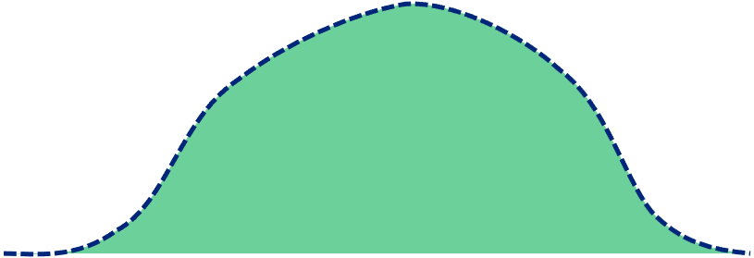
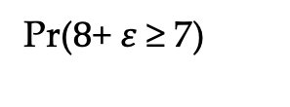

Semi-Personalized Pricing for General 𝜀
Market of n customers with associated features x_{i} ϵ X,
V| x_{i} = $μ$(x_{i}) + 𝜀
Objective: Choose k segments S_{i} and prices p(S_{i}) to maximize revenue
Example:
Pr($8$+ 𝜀 ≥ 7)
V|x₁ = $8$ + 𝜀
$7

Slide 20



Semi-Personalized Pricing for General 𝜀
Market of n customers with associated features x_{i} ϵ X,
V| x_{i} = $μ$(x_{i}) + 𝜀
Objective: Choose k segments S_{i} and prices p(S_{i}) to maximize revenue
Example:
$μ$(x₁) + 𝜀
$μ$(x₃) + 𝜀
$μ$(x₂) + 𝜀
$μ\left(x\right)$
$8
$14
$18
S₁
S₂

Slide 21
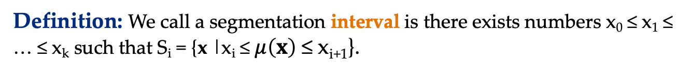
Structure of Optimal Pricing
Definition: We call a segmentation interval is there exists numbers x₀ ≤ x₁ ≤ … ≤ x_{k} such that S_{i} = {x |x_{i} ≤$μ\left(x\right)$ ≤ x_{i+1}}.
$μ\left(x\right)$
x₁
x₂
x₃
x₄
S₁
S₂
S₃
S₄
When 𝜀 arbitrary
Optimal segmentation is not necessarily interval!

Slide 22
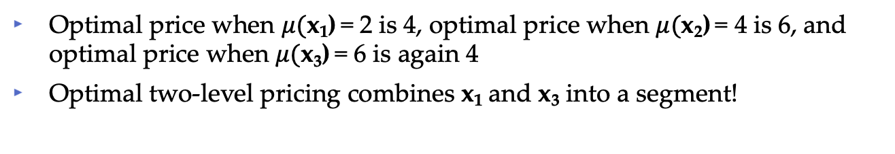
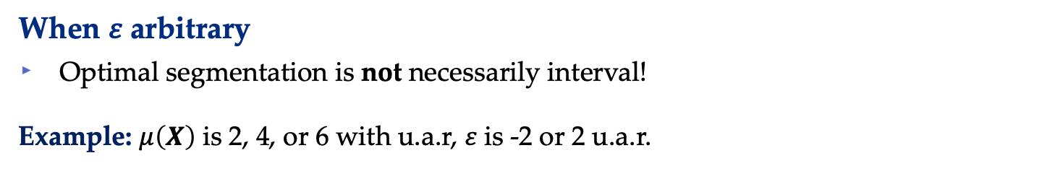
Structure of Optimal Pricing
Definition: We call a segmentation interval is there exists numbers x₀ ≤ x₁ ≤ … ≤ x_{k} such that S_{i} = {x |x_{i} ≤$μ\left(x\right)$ ≤ x_{i+1}}.
p(S₁) = 4
$2
$4
$6
p(S₂) = 6
When 𝜀 arbitrary
Optimal segmentation is not necessarily interval!
Example: $μ\left(X\right)$ is 2, 4, or 6 with u.a.r, 𝜀 is -2 or 2 u.a.r.
-2
+2
-2
+2
-2
+2
Optimal price when $μ($x₁) = 2 is 4, optimal price when $μ($x₂) = 4 is 6, and optimal price when $μ($x₃) = 6 is again 4
Optimal two-level pricing combines x₁ and x₃ into a segment!

Slide 23
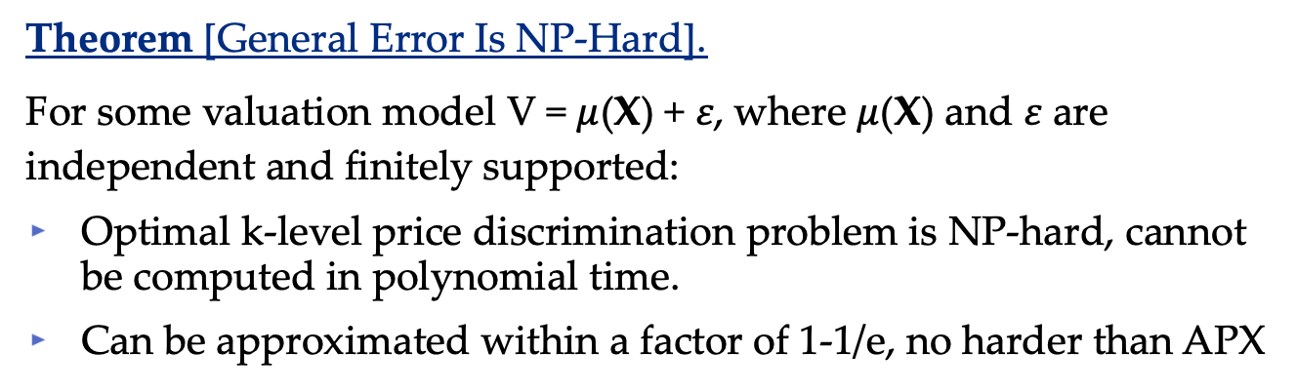
Hardness of Semi-Personalized Pricing
Theorem [General Error Is NP-Hard].
For some valuation model V = $μ$(X) + 𝜀, where $μ$(X) and 𝜀 are independent and finitely supported:
Optimal k-level price discrimination problem is NP-hard, cannot be computed in polynomial time.
Can be approximated within a factor of 1-1/e, no harder than APX
Takeaway
For general errors, there is no algorithm can compute the optimal FBMSP in polynomial time.
When 𝜀 was 0, we could intuitively see that the optimal segmentations were interval. This is necessary for efficient computation

Slide 24
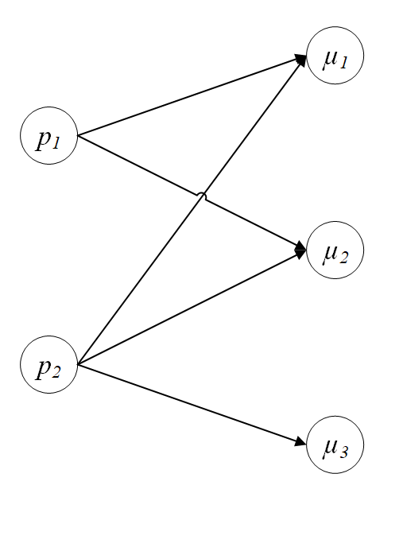
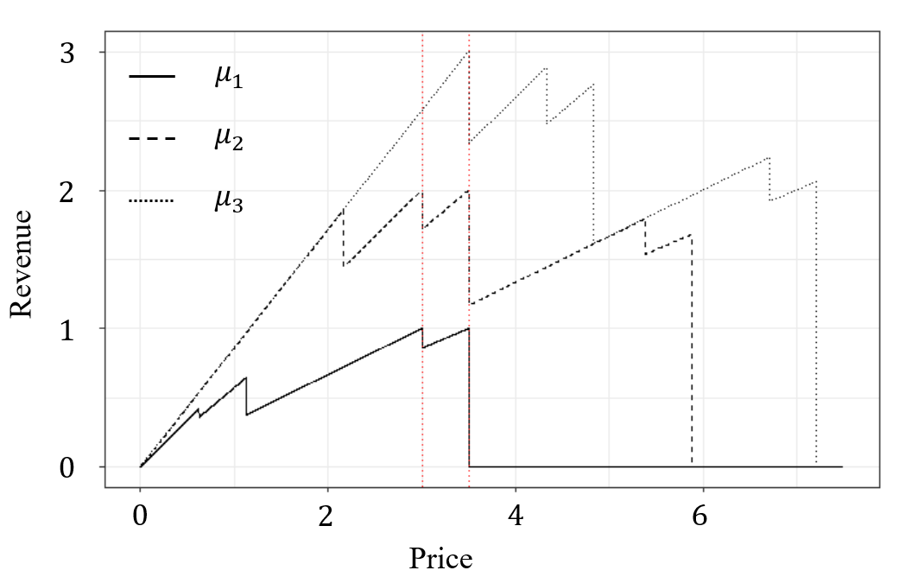
Hardness of Semi-Personalized Pricing
Theorem [General Error Is NP-Hard].
Takeaway
For general errors, there is no algorithm can compute the optimal FBMSP in polynomial time.
General k-Level Price Discrimination ⬄ Hitting Set

Slide 25
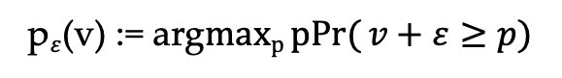
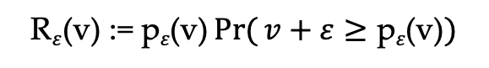
Tractable Semi-Personalized Pricing
When can optimal k-level price discrimination be efficiently computed in this model?
Independence means regression model simply translates the error distribution for different customers.
This results in a well-behaved revenue and pricing functions
p$\text{ε}$(v) := arg$\operatorname{maxp}{pPr(}v+\text{ε}≥p)$
R$\text{ε}$(v) := $\text{p}\text{ε}\text{(}\text{v}\text{)}{Pr(}v+\text{ε}≥\text{p}\text{ε}\text{(}\text{v}\text{)})$

Slide 26
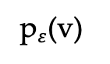
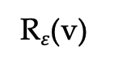
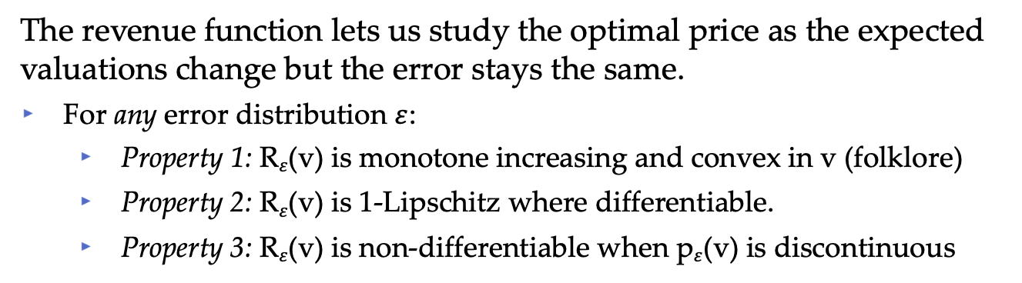
Tractable Semi-Personalized Pricing
The revenue function lets us study the optimal price as the expected valuations change but the error stays the same.
For any error distribution $\text{ε}$:
Property 1: R$\text{ε}$(v) is monotone increasing and convex in v (folklore)
Property 2: R$\text{ε}$(v) is 1-Lipschitz where differentiable.
Property 3: R$\text{ε}$(v) is non-differentiable when p$\text{ε}$(v) is discontinuous
p$\text{ε}$(v) := arg$\operatorname{maxp}{pPr(}v+\text{ε}≥p)$
p$\text{ε}$(v)
R$\text{ε}$(v)
R$\text{ε}$(v) := $\text{p}\text{ε}\text{(}\text{v}\text{)}{Pr(}v+\text{ε}≥\text{p}\text{ε}\text{(}\text{v}\text{)})$
v
v

Slide 27
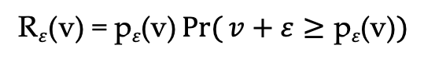
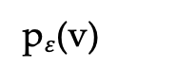
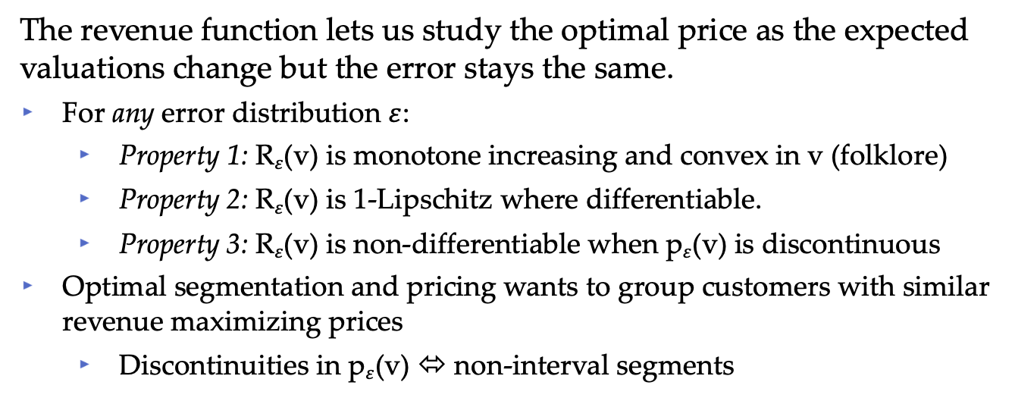
Tractable Semi-Personalized Pricing
The revenue function lets us study the optimal price as the expected valuations change but the error stays the same.
For any error distribution $\text{ε}$:
Property 1: R$\text{ε}$(v) is monotone increasing and convex in v (folklore)
Property 2: R$\text{ε}$(v) is 1-Lipschitz where differentiable.
Property 3: R$\text{ε}$(v) is non-differentiable when p$\text{ε}$(v) is discontinuous
Optimal segmentation and pricing wants to group customers with similar revenue maximizing prices
Discontinuities in p$\text{ε}$(v) ⬄ non-interval segments
p$\text{ε}$(v) = arg$\operatorname{maxp}{pPr(}v+\text{ε}≥p)$
p$\text{ε}$(v)
R$\text{ε}$(v) = $\text{p}\text{ε}\text{(}\text{v}\text{)}{Pr(}v+\text{ε}≥\text{p}\text{ε}\text{(}\text{v}\text{)})$
v

Slide 28
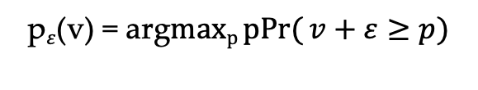
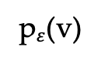
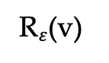
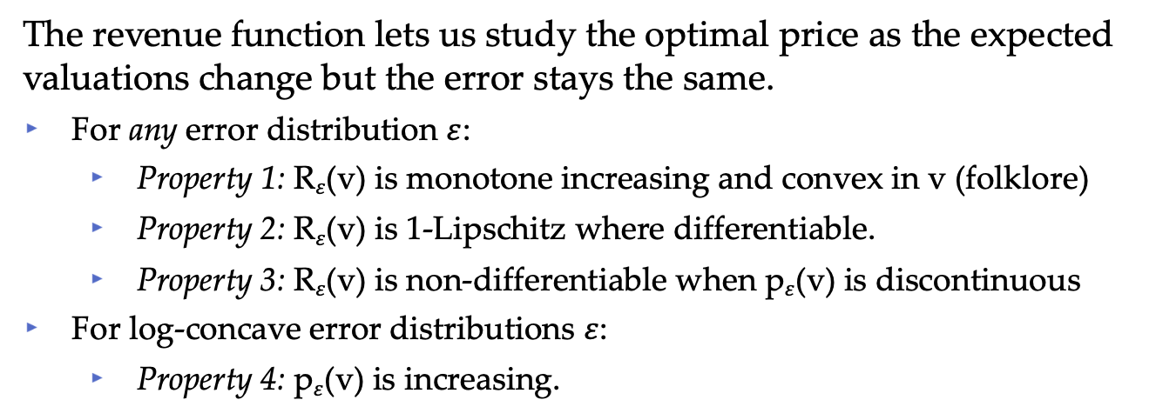
Tractable Semi-Personalized Pricing
The revenue function lets us study the optimal price as the expected valuations change but the error stays the same.
For any error distribution $\text{ε}$:
Property 1: R$\text{ε}$(v) is monotone increasing and convex in v (folklore)
Property 2: R$\text{ε}$(v) is 1-Lipschitz where differentiable.
Property 3: R$\text{ε}$(v) is non-differentiable when p$\text{ε}$(v) is discontinuous
For log-concave error distributions $\text{ε}$:
Property 4: p$\text{ε}$(v) is increasing.
p$\text{ε}$(v) = arg$\operatorname{maxp}{pPr(}v+\text{ε}≥p)$
p$\text{ε}$(v)
R$\text{ε}$(v)
R$\text{ε}$(v) = $\text{p}\text{ε}\text{(}\text{v}\text{)}{Pr(}v+\text{ε}≥\text{p}\text{ε}\text{(}\text{v}\text{)})$
v
v

Slide 29
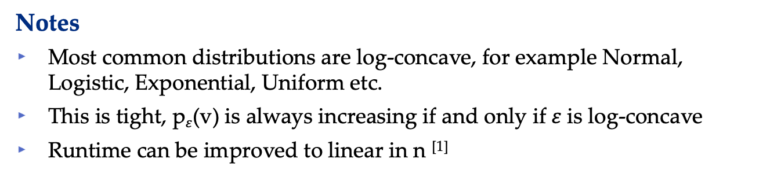
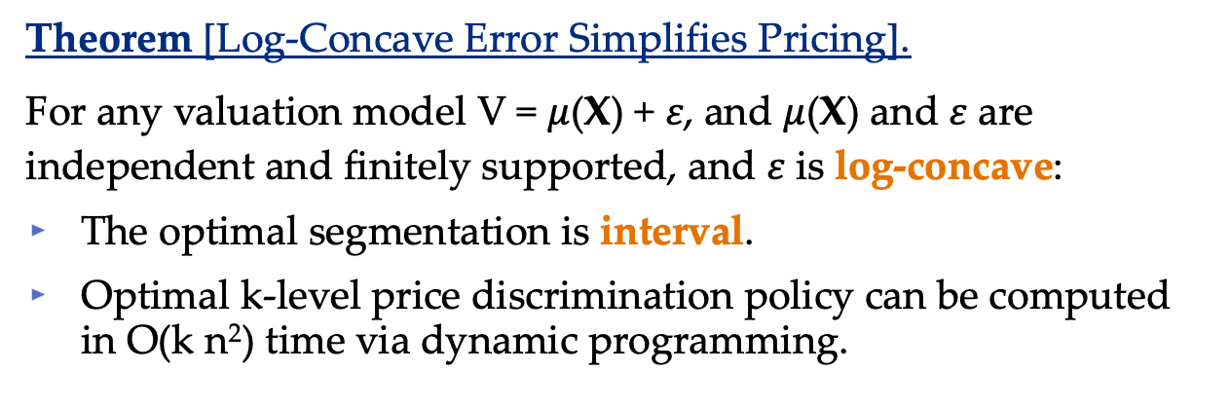
Tractable Semi-Personalized Pricing
Theorem [Log-Concave Error Simplifies Pricing].
For any valuation model V = $μ$(X) + 𝜀, and $μ$(X) and 𝜀 are independent and finitely supported, and 𝜀 is log-concave:
The optimal segmentation is interval.
Optimal k-level price discrimination policy can be computed in O(k n²) time via dynamic programming.
Notes
Most common distributions are log-concave, for example Normal, Logistic, Exponential, Uniform etc.
This is tight, p$\text{ε}$(v) is always increasing if and only if 𝜀 is log-concave
Runtime can be improved to linear in n ^{[1]}
[1] Gronlund et al, 2017. Fast Exact k-Means, k-Medians and Bregman Divergence Clustering in 1D

Slide 30
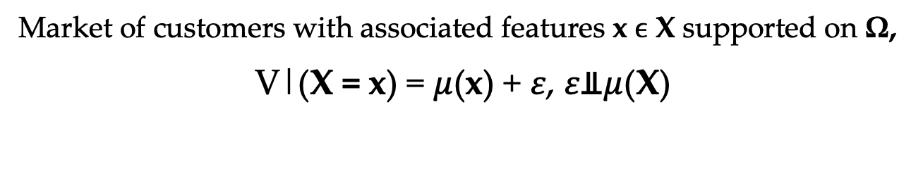
Recap
Market of customers with associated features x ϵ X supported on Ω,
V|(X = x) = $μ$(x) + 𝜀, 𝜀⫫$μ$(X)
k-Level Price Discrimination (kXP)
Divide feature-space into k segments S_{i} ⊆ Ω, with price per segment p(S_{i}).
For each customer, observe feature x and offer segment price.
R_{kXP} = max $\sum_{i}{p(}$S_{i}) Pr($μ$(X) + 𝜀 ≥ p(S_{i})|X ϵ S_{i}) Pr(X ϵ S_{i})
{S_{i}, p(S_{i})}
This is NP-Hard for general error, even when independent of features
This is easy to solve when the error is log-concave
This includes when valuations are predicted according to linear regression with normal error
Problem is well structured

Slide 31
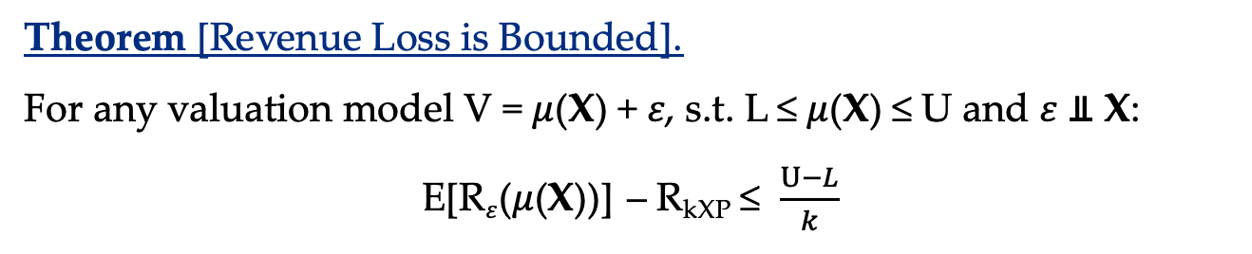
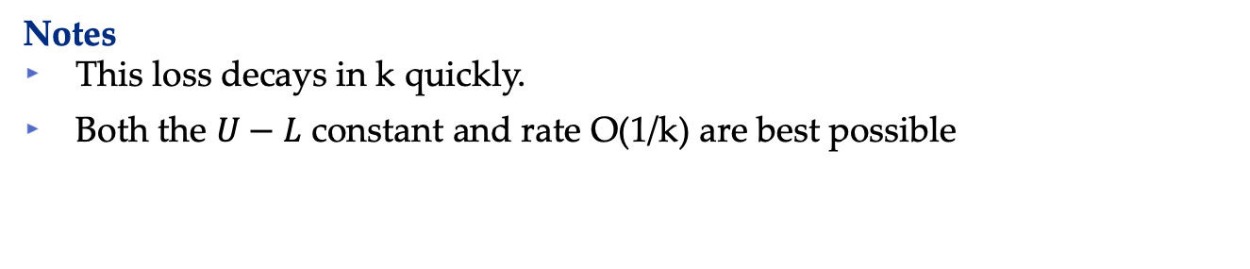
As the Level Varies in Semi-Personalized Pricing
Theorem [Revenue Loss is Bounded].
For any valuation model V = $μ$(X) + 𝜀, s.t. L ≤ $μ$(X) ≤ U and 𝜀 ⫫ X:
E[R$\text{ε}$($μ$(X))] – R_{kXP} ≤ $\frac{U−L}{k}$
Notes
This loss decays in k quickly.
Both the $U−L$ constant and rate O(1/k) are best possible

Slide 32
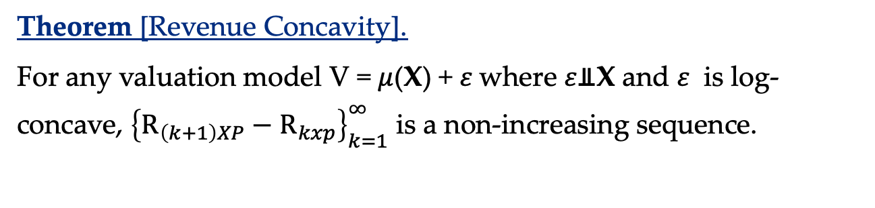

As the Level Varies in Semi-Personalized Pricing
Theorem [Revenue Loss is Bounded].
For any valuation model V = $μ$(X) + 𝜀, s.t. L ≤ $μ$(X) ≤ U and 𝜀 ⫫ X:
E[R$\text{ε}$($μ$(X))] – R_{kXP} ≤ $\frac{U−L}{k}$
Theorem [Revenue Concavity].
For any valuation model V = $μ$(X) + 𝜀 where 𝜀⫫X and 𝜀 is log-concave, ${\left\{R_{\left(k+1\right)XP}−R_{kxp}\right\}}_{k=1}^{∞}$ is a non-increasing sequence.
Notes
This loss decays in k fast
Both the $U−L$ constant and the rate of O(1/k) can not be improved.
Notes
Many other results in the paper to help choose k

Slide 33

What About Customer Welfare?
Q2: Do these pricing policies help or hurt customers? (𝜀 = 0)
Market of customers with known valuations V ~ F, $\overline{F}$ := 1 - F(x)
k-Level Price Discrimination (kP)
Divide valuation-space into k intervals with a price at bottom of interval
For each customer, observe valuation and offer segment price.
R_{kP} = max $\sum_{i}{\text{p}\text{i}\text{,}\text{k}}$ ($\overline{F}$(p_{i,k}) - $\overline{F}$(p_{i+1,k}))
Where p_{1,k} ≤ p_{2,k} ≤ … ≤ p_{k,k}
Model Notes
Perfect sorting by valuation, segments interval
Limited by number of prices

Slide 34











What About Customer Welfare?
Q2: Do these pricing policies help or hurt customers? (𝜀 = 0)
Revenue
$$\overline{F}$$
$$\overline{F}$$
$$\overline{F}$$
Surplus
Deadweight Loss
$$\overline{F}(p1,2)$$
$$\overline{F}(p1,1)$$
$$\overline{F}(p2,2)$$
$$p1,1=1/2$$
$$v$$
$$p1,2=1/3,$$
$p2,2=2/$3
$$v$$
$$v$$
(a) One Price
(b) Two Prices
(c) Multiple Prices

Slide 35



What About Customer Welfare?
Q2: Do these pricing policies help or hurt customers? (𝜀 = 0)
When k is large, all valuation is converted to revenue
Price discrimination can benefit those with the lower ability to pay
Revenue
$$\overline{F}$$
$$\overline{F}$$
$$\overline{F}$$
Surplus
Deadweight Loss
$$\overline{F}(p1,2)$$
$$\overline{F}(p1,1)$$
$$\overline{F}(p2,2)$$
$$p1,1=1/2$$
$$v$$
$$p1,2=1/3,$$
$p2,2=2/$3
$$v$$
$$v$$
(a) One Price
(b) Two Prices
(c) Multiple Prices

Slide 36
What About Customer Welfare?
Q2: Do these pricing policies help or hurt customers? (𝜀 = 0)
When k is large, all valuation is converted to revenue
Price discrimination can benefit those with the lower ability to pay
Some customers pay less
$$\overline{F}$$
$$\overline{F}$$
$$\overline{F}$$
$$\overline{F}(p1,2)$$
$$\overline{F}(p1,1)$$
$$\overline{F}(p2,2)$$
$$p1,1=1/2$$
$$v$$
$$p1,2=1/3,$$
$p2,2=2/$3
$$v$$
$$v$$
(a) One Price
(b) Two Prices
(c) Multiple Prices

Slide 37












Traditional Customer Surplus
The traditional surplus for each customer is $v−p$.
For Uniform[0,1] valuations, surplus is decreased by price discrimination
$Total Surplus(k=1)=\int_{\frac{1}{2}}^{1}{(v−\frac{1}{2})}dv$ = 1/8
$$\overline{F}$$
$$\overline{F}$$
$Total Surplus(k=2)=\int_{\frac{1}{3}}^{\frac{2}{3}}{(v−\frac{1}{3})}dv+\int_{\frac{2}{3}}^{1}{(v−\frac{2}{3})}dv$ = 1/9
$$\overline{F}(p1,2)$$
$$\overline{F}(p1,1)$$
$$\overline{F}(p2,2)$$
$$p1,1=1/2$$
$$v$$
$$p1,2=1/3,$$
$p2,2=2/$3
$$v$$
(a) One Price
(b) Two Prices

Slide 38








Traditional Customer Surplus
The traditional surplus for each customer is $v−p$.
For Uniform[0,1] valuations, surplus is decreased by price discrimination
Majority of the surplus is enjoyed by those with high valuations
$$\overline{F}$$
$Total Surplus(k=2)=\int_{\frac{1}{3}}^{\frac{2}{3}}{(v−\frac{1}{3})}dv+\int_{\frac{2}{3}}^{1}{(v−\frac{2}{3})}dv$ = 1/9
$$\frac{Surplus in [\frac{1}{3},\frac{4}{9}]}{Total Surplus}=\frac{1}{18}$$
$$\overline{F}(p1,2)$$
$$\overline{F}(p2,2)$$
$$\frac{Surplus in [\frac{8}{9},1]}{Total Surplus}=\frac{5}{18}$$
$$p1,2=1/3,$$
$p2,2=2/$3
$$v$$
(b) Two Prices

Slide 39


Equitable Measures of Surplus
The traditional surplus for each customer is $v−p$.
For Uniform[0,1] valuations, surplus is decreased by price discrimination
In general profit-maximizing price discrimination reduces trad. surplus ^{[1,2,3]}
Values gains made by least able and most able equally
The proportional surplus upweights gains made by those with least ability
$$\frac{v−p}{v}$$
Q2*: Does price discrimination help from the perspective of proportional surplus?
[1] Robinson, Joan. 1969. The economics of imperfect competition
[2] Yamey, Basil. 1974. Monopolistic price discrimination and economic welfare. The Journal of Law and Economics
[3] Schmalensee, Richard. 1981. Output and welfare implications of monopolistic third-degree price discrimination

Slide 40






Some Notation
Q2*: Does price discrimination help from the perspective of proportional surplus?
Valuations are drawn from a distribution $F(v)$ with a density $f(v)$and survival function $\overline{F}(v)$. Let ${\{p}_{i,k}^{∗}\}$ be k-level revenue maximizing prices.
Revenue: $R_{k}=\sum_{i=1}^{k}{p_{i,k}^{∗}(\overline{F}(p_{i,k}^{∗})\text{−}\overline{F}(p_{i+1,k}^{∗}))}$
Traditional Surplus: $S_{k}^{T}=\sum_{i=1}^{k}{\int_{p_{i,k}^{∗}}^{p_{i+1,k}^{∗}}{\left(v−p_{i,k}^{∗}\right)f\left(v\right) dv}}$
Proportional Surplus: $S_{k}^{P}=\sum_{i=1}^{k}{\int_{p_{i,k}^{∗}}^{p_{i+1,k}^{∗}}{\frac{v−p_{i,k}^{∗}}{v}f\left(v\right) dv}}$
$ $p_{1,1}$
$ $p_{1,2}$
$ $p_{2,2}$

Slide 41















Proof of Concept: Linear Demand
Example: Uniform[0,1] valuations, revenue maximizing prices
$$\overline{F}(v)$$
$$\overline{F}(v)$$
$$1$$
$$1$$
Deadweight Loss
Deadweight Loss
$$\overline{F}(p_{2,2}^{∗})$$
$$\overline{F}(p_{1,1}^{∗})$$
Customer
Surplus
Customer
Surplus
$$\overline{F}(p_{1,2}^{∗})$$
Revenue
Revenue
$$0$$
$$p_{1,1}^{∗}=1/2$$
$$1$$
$$v$$
$$0$$
$$p_{1,2}^{∗}=1/3$$
$$p_{2,2}^{∗}=2/3$$
$$1$$
$$v$$
(a) Uniform Pricing
(b) 2-Level Discr. Pricing
Traditional Surplus: $S_{1}^{T}=0.13$, $S_{2}^{T}=0.11$
Proportional Surplus: $S_{1}^{P}=0.15$, $S_{2}^{P}=0.17$

Slide 42





Proof of Concept: Linear Demand
Theorem [Linear Demand]
When valuations are Uniform[0, 1], the traditional surplus $S_{k}^{T}$ is maximized under uniform pricing (k = 1), whereas the proportional surplus $S_{k}^{P}$is maximized by two-level price discrimination (k = 2)
$$S_{k}^{T}$$
$$S_{k}^{P}$$
k
k
(a) Traditional Surplus
(b) Proportional Surplus

Slide 43

Beyond Linear Demand
The class of Pareto-Pickands(z) distributions generalizes the uniform
cCDF: ${\overline{F}}_{z}\left(v\right)=\left\{\begin{aligned}{(1+zv)}^{−1/z}, z≠0 \\ e^{−z}, z=0\end{aligned}\right., v≥0, z<1$;
pdf: $f_{z}\left(v\right)=\left\{\begin{aligned}{(1+zv)}^{−1/z−1}, z≠0 \\ e^{−z}, z=0\end{aligned}\right., v≥0, z<1$;
It includes widely-used distributions like the uniform, exponential, and certain cases of Pareto and Beta distributions.
This distribution is often used to model income disparity, as it captures the most relevant aspects of income distribution^{1,2}.
One parameter z (scale is set to 1 WLOG) controls weight of tail
[1] Drăgulescu and Yakovenko. 2001. Exponential and power-law probability distributions of wealth and income[…]
[2] Jones, Charles I. 2015. Pareto and Piketty: The Macroeconomics of top income and wealth inequality

Slide 44


Beyond Linear Demand
The class of Pareto-Pickands(z) distributions generalizes the uniform
cCDF: ${\overline{F}}_{z}\left(v\right)=\left\{\begin{aligned}{(1+zv)}^{−1/z}, z≠0 \\ e^{−z}, z=0\end{aligned}\right., v≥0, z<1$;
pdf: $f_{z}\left(v\right)=\left\{\begin{aligned}{(1+zv)}^{−1/z−1}, z≠0 \\ e^{−z}, z=0\end{aligned}\right., v≥0, z<1$;

Slide 45


Price Discr. is Prop. Surplus Increasing
Theorem [Proportional Surplus and the Pareto-Pickands].
When valuations are Pareto-Pickands(z) with z > -2.42, the traditional surplus $S_{k}^{T}$ is higher under uniform pricing (k = 1) than two-level discriminatory pricing (k=2), whereas the proportional surplus $S_{k}^{P}$is higher under two-level price discrimination (k = 2) than under uniform pricing, i.e.
$S_{1}^{T}≥$ $S_{2}^{T}$ and $S_{1}^{P}≤$ $S_{2}^{P}$

Slide 46
Price Discr. is Prop. Surplus Increasing
Theorem [Proportional Surplus and the Pareto-Pickands].
When valuations are Pareto-Pickands(z) with z > -2.42, the traditional surplus $S_{k}^{T}$ is higher under uniform pricing (k = 1) than two-level discriminatory pricing (k=2), whereas the proportional surplus $S_{k}^{P}$is higher under two-level price discrimination (k = 2) than under uniform pricing, i.e.
$S_{1}^{T}≥$ $S_{2}^{T}$ and $S_{1}^{P}≤$ $S_{2}^{P}$
In general, price discrimination does not improve customer surplus, however a modest level of price discrimination improves prop. surplus
Two-level price discrimination ⬄ Coupons, targeted discounts
Two is increasing, optimal can be higher level. For exponential, optimal level of price discrimination for proportional surplus is k = 3!

Slide 47
Conclusions
We introduce a hierarchy of semi-personalized pricing policies which reflect the way personalized pricing are implemented in practice
Under natural regression assumptions, we characterize when k-level price discrimination can be efficiently computed – namely when error is log-concave
We studied how semi-personalized pricing, which does not improve customer surplus in a traditional sense, can be equity improving by increasing proportional surplus. In this way, moderate levels of price discrimination can be a win-win for firms and their customers
Final Thought: These results are general, but personalized pricing is most interesting/effective when it is tailored to the context. Future work on how/what exactly to implement in different markets

Slide 48



Thank you!
This work combines two papers:
Optimal Feature-Based Market Segmentation and Pricing (Major at OR): https://papers.ssrn.com/sol3/papers.cfm?abstract_id=4151103
Can Price Discrimination be Progressive? (Available upon request)
Comments, questions mih140@pitt.edu
More papers: https://mhamilton-pitt.github.io/

